Slide 1
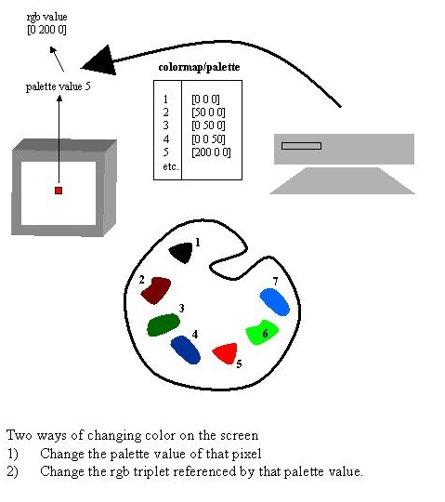
COLORMAPS p. 22
RGB value
[200 0 0]

Slide 2
Other demo
Display to the Figure window an image of a grayscale horizontal sinusoidal grating (size 200 x 200)
grate = zeros(200,200);
for n=1:200
grate(n,:) = 256 * (abs(sin(2*pi*n/200)));
end;
colormap(gray(256));
image(grate);
axis off;
axis equal;

Slide 3
In class exercise (1)
1.Image(X) from Durer and adjust brightness to use full grayscale (256 levels).
X2 = X.*2; %(cheap cheat)

Slide 4
In class exercise (1)
2.Display the durer image on a background of white and red stripes. Each background stripe should be 24 pixels.
newmap1 = colormap(gray(128));
newmap2 = newmap1;
newmap2(:,2) = 0;
newmap2(:,3) = 0;
newmap = [newmap1;newmap2];

Slide 5
In class exercise (1)
with a for loop, every 24 lines, you add 128 to color index
image has 27 'bands'
create a matrix with these bands
zer = zeros(24,width_of_X)
one = ones(24,width_of_X)
conc = [zer;one]
newX = repmat(conc,13,1);
newX = [newX;zer];
newX = newX .*128; % 1 -> 128, 0 stay!
newX = newX + X; %done! “moved” %indeces to lower part of CLUT!
image(newX);
colormap(newmap);

Slide 6
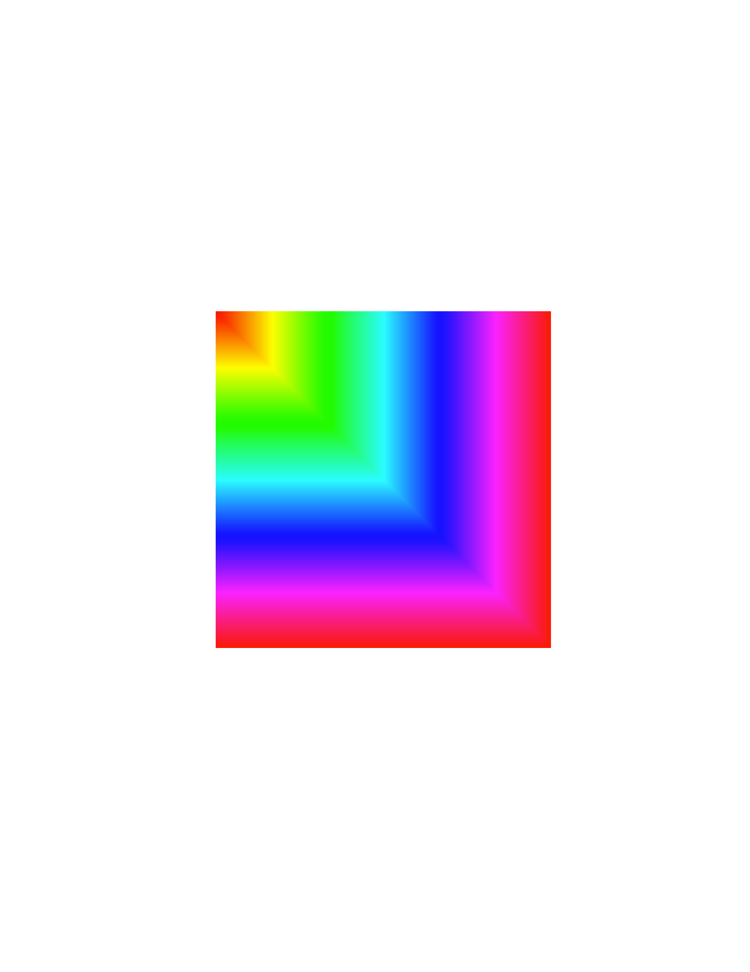
Exercise
Create the following figure.
  A 256 by 256 matrix
  Colormap(hsv(256))

Slide 7
Exercise
clear;
A = zeros(256,256)
for i = 1:256
for j = 1:256
A(i,j) = max(i,j);
end
end
colormap(hsv(256));
image(A)

Slide 8
Homework/in class exercises
1. durernoise.m Create a program that creates 5 different versions of the durer image with increasing levels of noise, using the same grayscale(256) CLUT, all in one single image (BMP)
2. rgbnoise.m Create a programm that takes the visionlab jpg logo and presents it in 2 different levels of black and white noise and two different levels of color noise, all in one single image that includes the untouched original.
3. Submit both images and corresponding script files.

Slide 9
Extra-credit
Write a “blocky” color map. That is, one in which the user gets to specify the length and width of the mask (in pixels) as well as the size of each individual “square” of color in the noise image.
+2 points
Submit code and example image with mask of 200 x 200 and squares of 15x15 pixels.

